Slide 1
Introduction
Cloud-based
Healthcare Apps
23. november, 2022
​
Thomas T. Hildebrandt, Professor, DIKU
Tilman Zuckmantel, PhD Student, DIKU

Slide 2
Agenda
09-10 : Introduction to the course, small introduction to distributed systems
10:15-11: Small introduction to UI programming

Slide 3
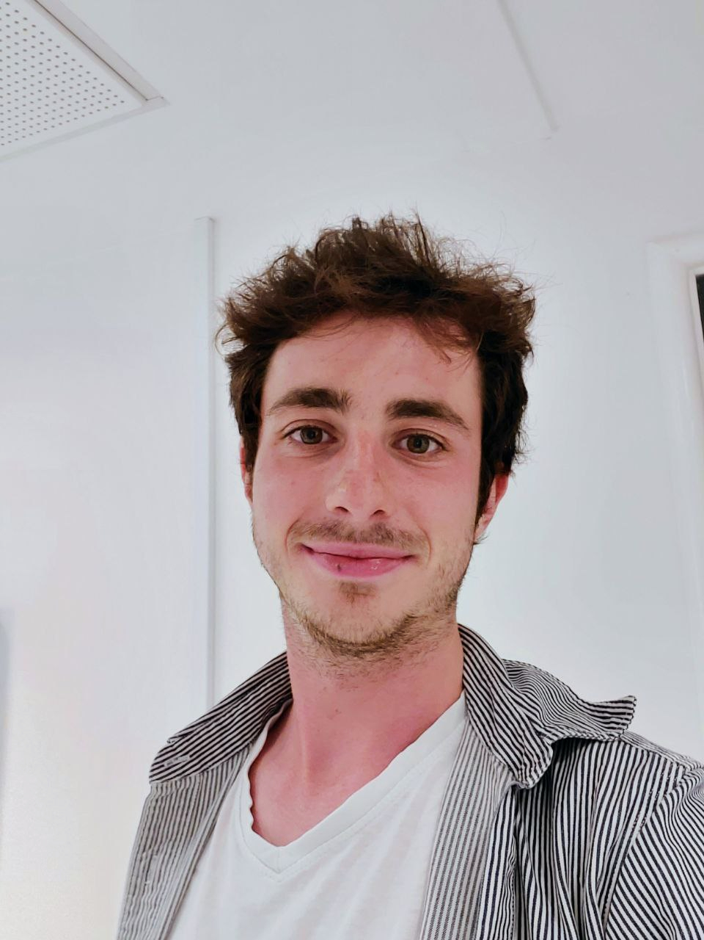
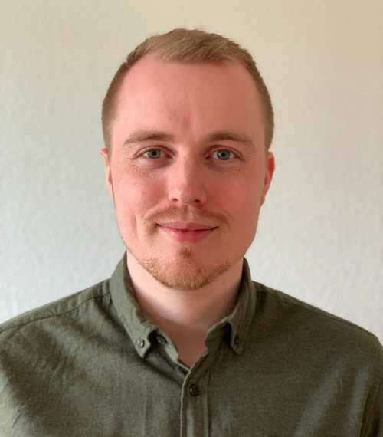
Teaching Personal
Lecturer: Thomas Hildebrandt & Tilman Zuckmantel
Teaching Assistants: Mikkel Leonhard Fuchs

Slide 4
Who am I ?

Slide 5
What Are You Going to Learn ?
Concepts:
Distributed Systems, Asynchronous Programming, Process-aware systems, IT-Security and Legal Aspects
Technologies:
- Programming Language -> Python,
- Process aware systems -> DCR Solutions Tools,
- Storing and Accesing Data in the Cloud -> Azure Cloud Solutions
- User Interface -> Kivy

Slide 6
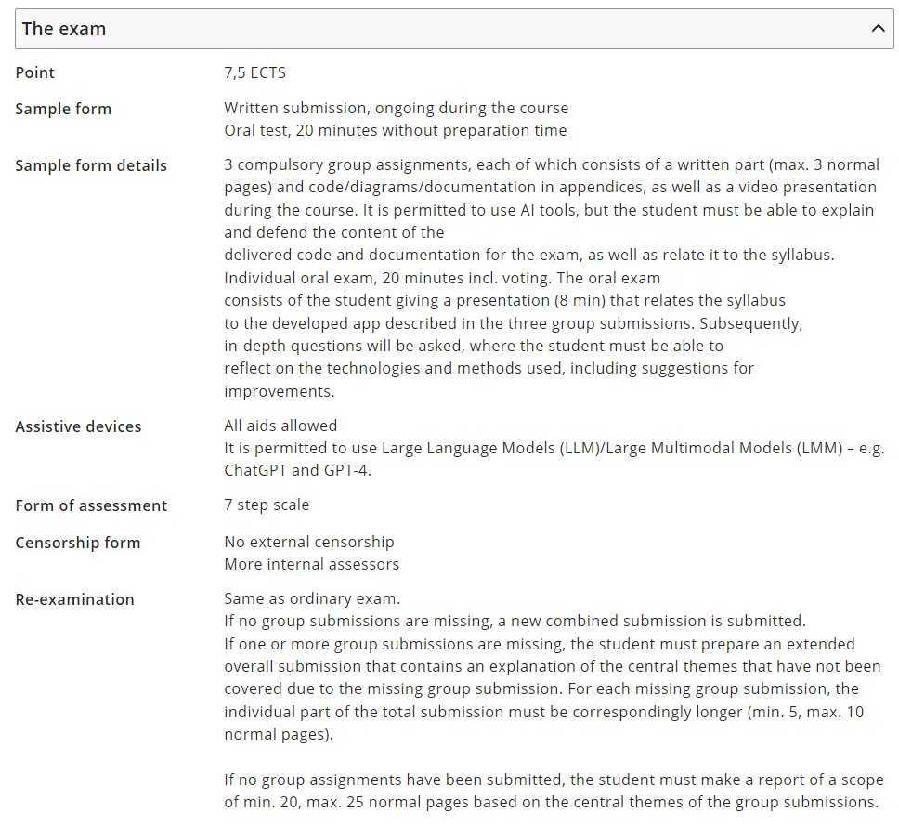

Slide 7
Schedule
Introduction (week 0)
Distributed and Process-Aware Systems (week 1-3)
1. Excercise Hand-In: TODO Application (18. December)
Database in the Cloud (week 4-5)
2. Excercise Hand-In: Advanced TODO Application (3. January)
Security and Course Conclusion (week 6 - 7)
3. Excercise Hand-In : Final TODO Application (15. January)
Oral Exams (23., 24. January)

Slide 8
The Outcome on One Slide
App development
in Python (Kivy)
Asynchronous
communication
Process repository & engine as a service
Workflow design tools
Legal aspects
Database access service
Data storage in cloud (AWS)
and security
Cloud storage

Slide 9
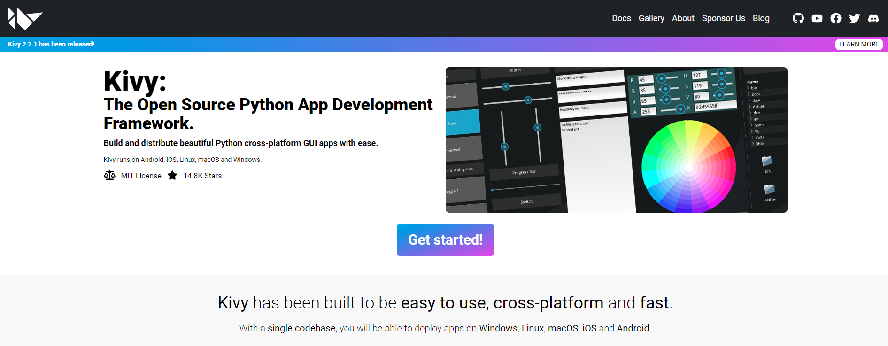

Slide 10
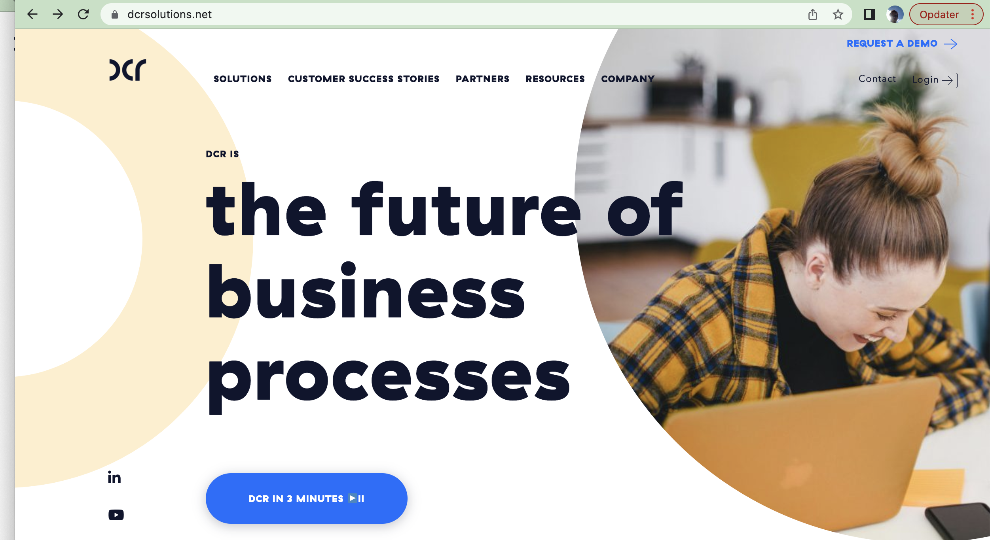
DCR Solutions workflow design and execution tools
Login

Slide 11
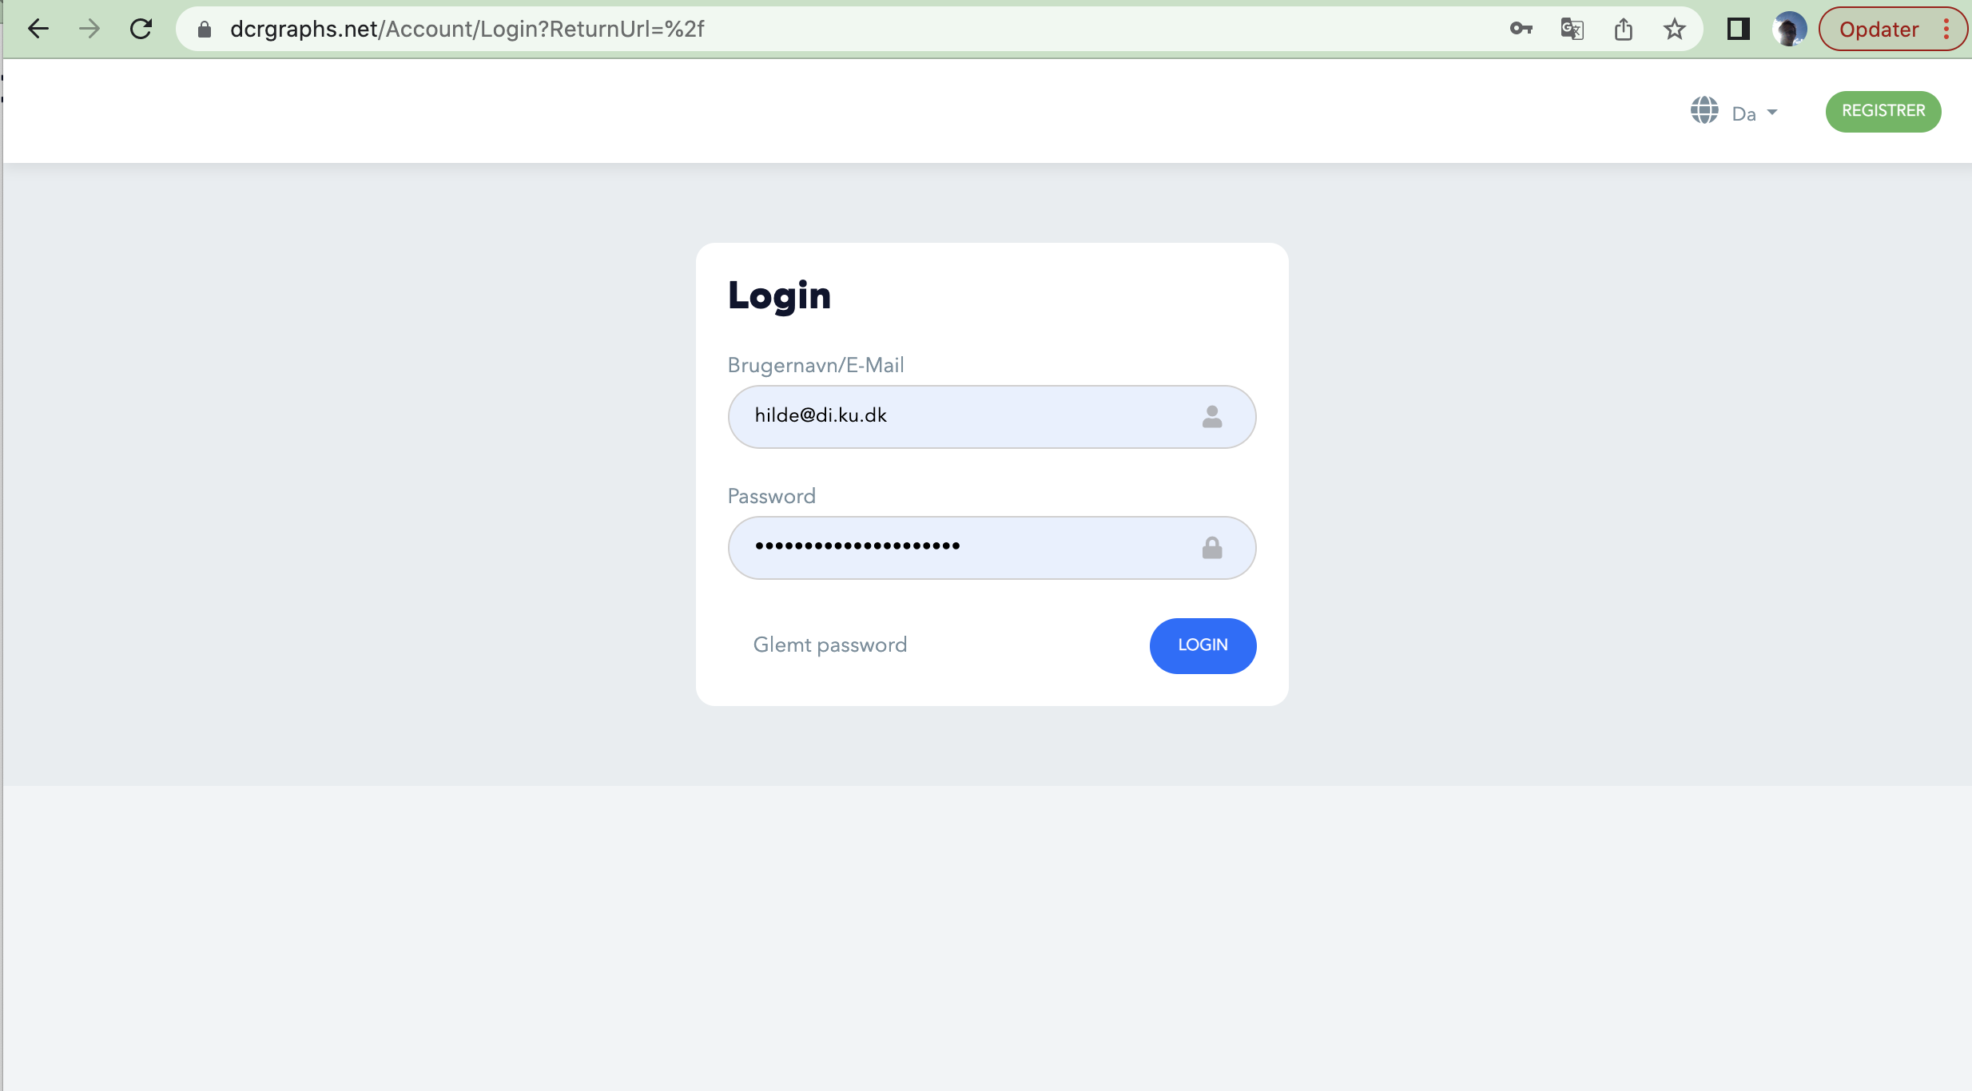
Registrer for at oprette en gratis konto
Register

Slide 12
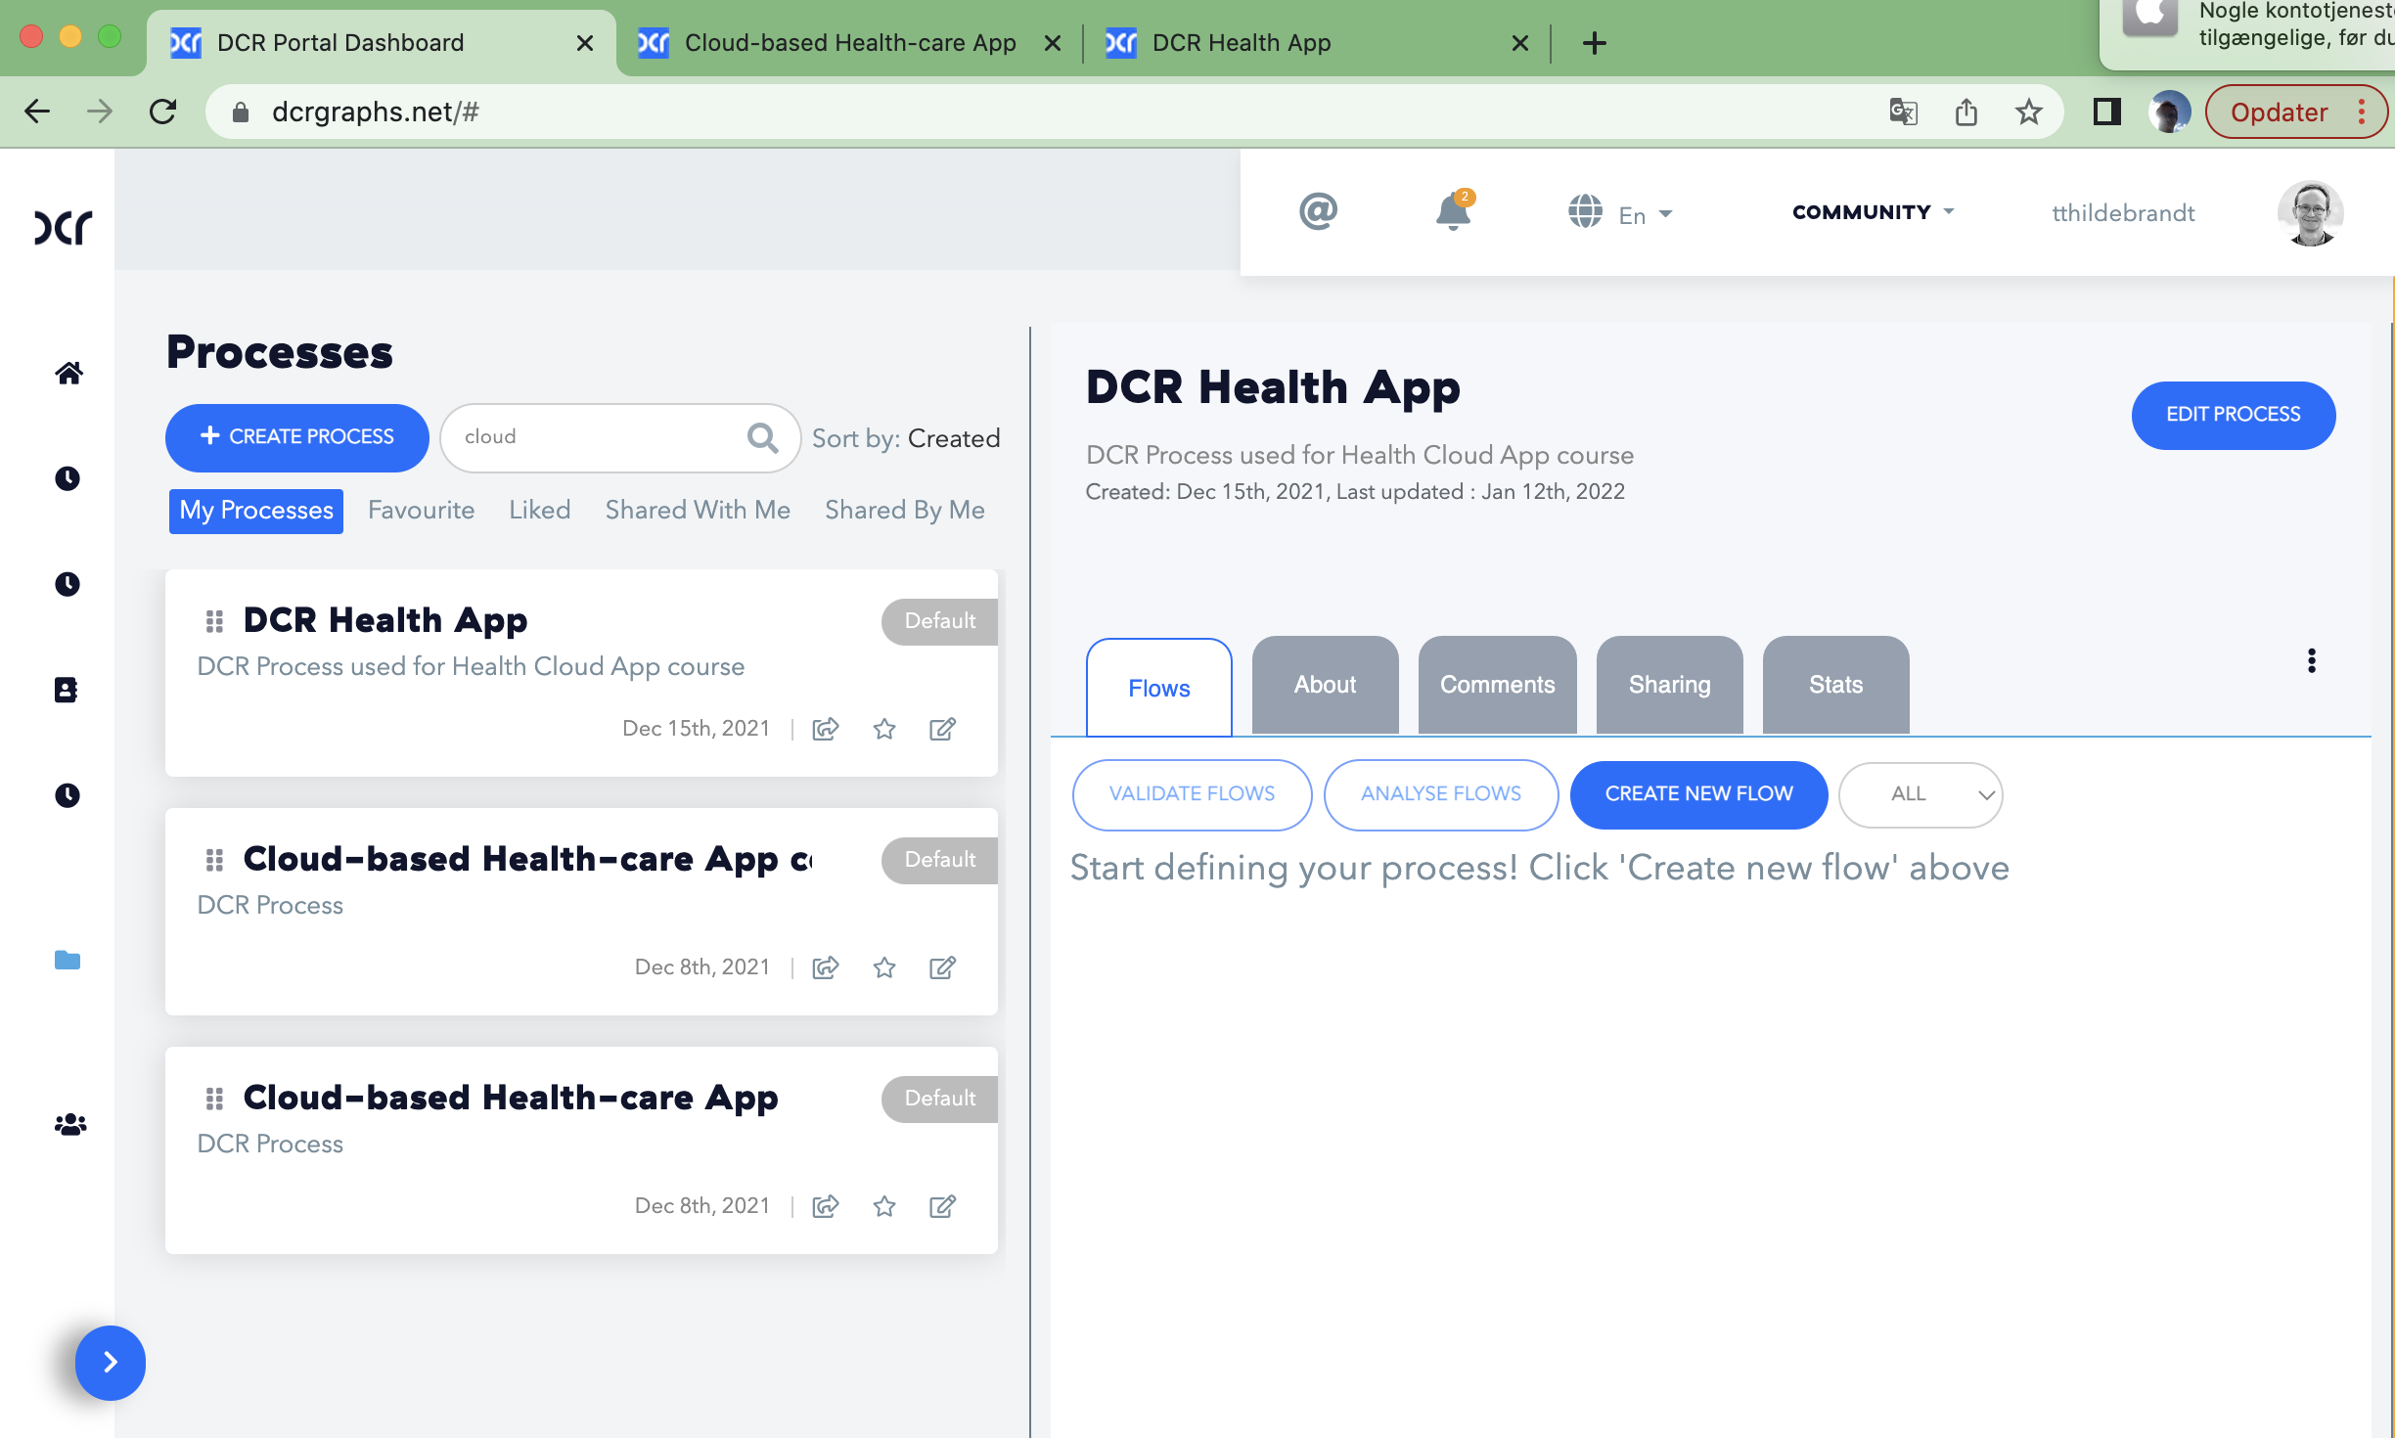
DCR Solutions processoverblik

Slide 13
DCR Solutions workflow design og execution tools
Resources

Slide 14
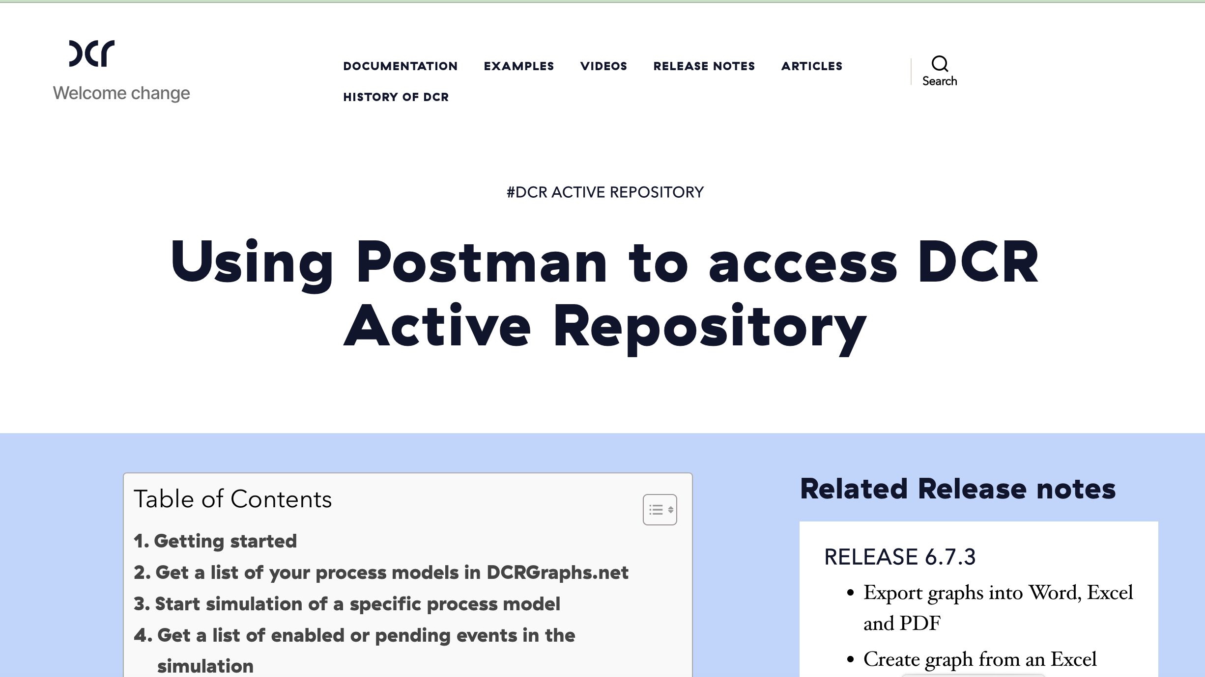
DCR Active Repository
https://documentation.dcr.design/documentation/using-postman-to-access-dcr-active-repository/

